Slide 1
Operating Systems

Slide 2
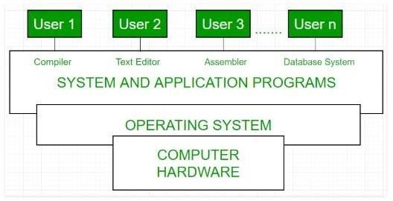
Operating Systems
It’s a system software that allows a user to run other applications on a computing device and acts as an intermediary between a user of a computer and the computer hardware.
Notes:
An Operating System is a software that acts as an intermediate between the hardware and the user. It is a kind of resource manager that manages both hardware and software resources of a system

Slide 3
What do operating systems do?
Allocation of resources
Memory management
User Interface
Resources
Memory , CPU, files, printer, data or any I/O devices , anything that is needed to complete tasks.

Slide 4
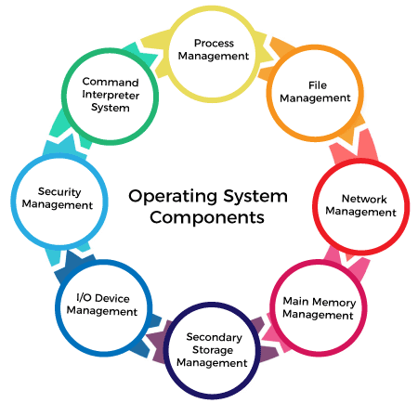

Slide 5
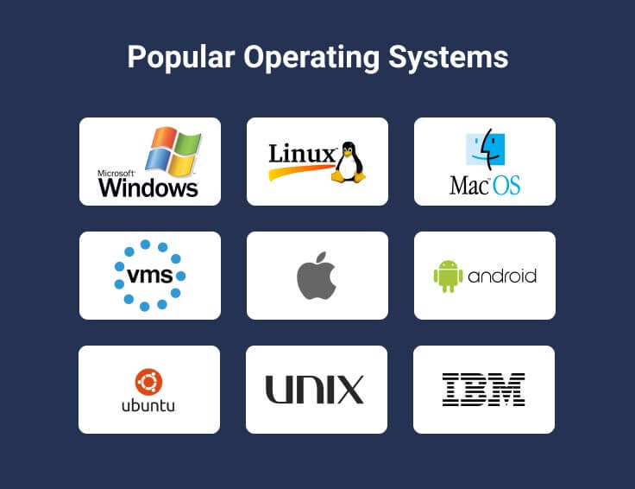
Examples of Operating Systems
Notes:
Windows
Linux
Mac OS
Ubuntu
Android
iOS
The Linux is highly secure and robust. It is used for enterprise level applications as it is highly reliable and stable. On the other hand, Ubuntu is a distribution of Linux, and it has almost all the features of Linux. Linux is an open source, free to use operating system widely used for computer hardware and software, game development, tablet PCS, mainframes etc. Unix is an operating system commonly used in internet servers, workstations and PCs by Solaris, Intel, HP etc.
Organizations still use the OpenVMS operating system to run critical processes. OpenVMS is reliable and secure, but expensive to maintain.

Slide 6
Goals of Operating System
Primary Goal: The primary goal of an Operating System is to provide a user-friendly and convenient environment.
Secondary Goal: The secondary goal of an Operating System is efficiency. The Operating System should perform all the management of resources in such a way that the resources are fully utilized and no resource should be held idle if some request to that resource is there at that instant of time.

Slide 7
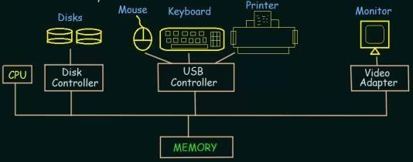
Computer System Operation
A modern general purpose computer consists of one or more CPUs and a number of device controllers connected through a common bus that provides access to a shared memory.
BUS

Slide 8
Each device controller is in charge of specific type of device.
The CPU and device controllers can execute concurrently (at the same time )competing for memory cycles.
Memory controller synchronize access to the memory.

Slide 9
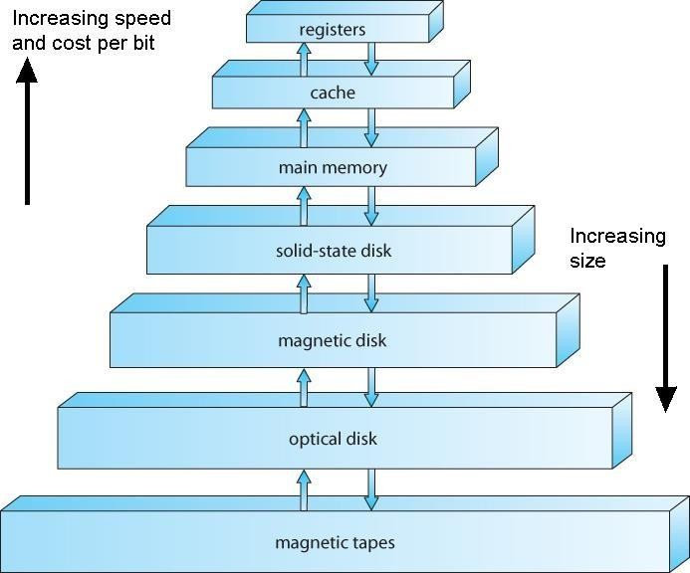
Storage Structure
Volatile:
Loses its contents when power is removed.
Non Volatile: Retain its contents even when power is removed.
Notes:
Registers: smallest storage device, stores in bits 0s and 1s, accessed quickly
Cache: size a little bigger, speed a little slower.

Slide 10
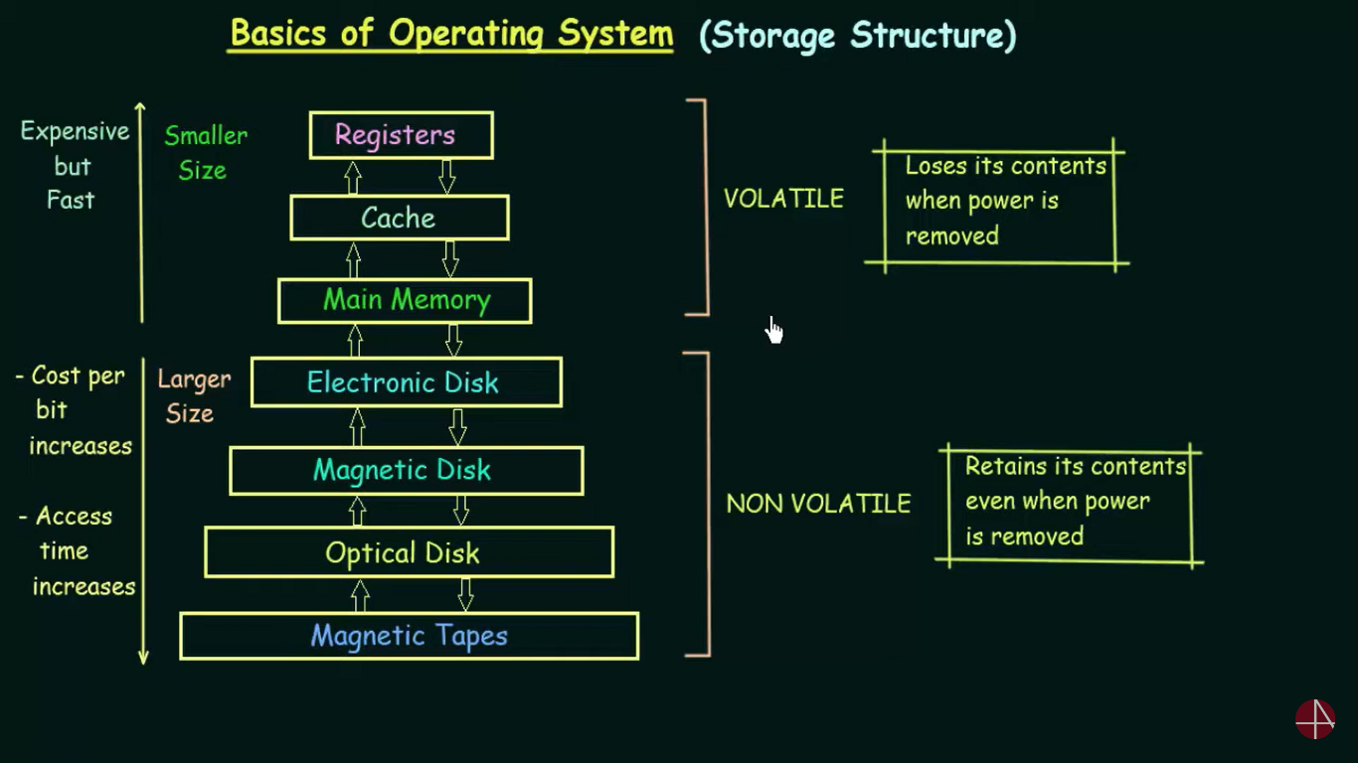

Slide 11
Types of Operating System
Batch Operating System
Multitasking OS
Multiprogramming OS
Multiprocessing OS
Distributed OS

Slide 12
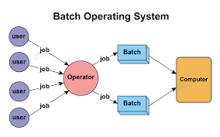
Batch Operating System
This type of operating system does not interact with the computer directly.
There is an operator which takes similar jobs having the same requirement and group them into batches.
It is the responsibility of the operator to sort jobs with similar needs.

Slide 13
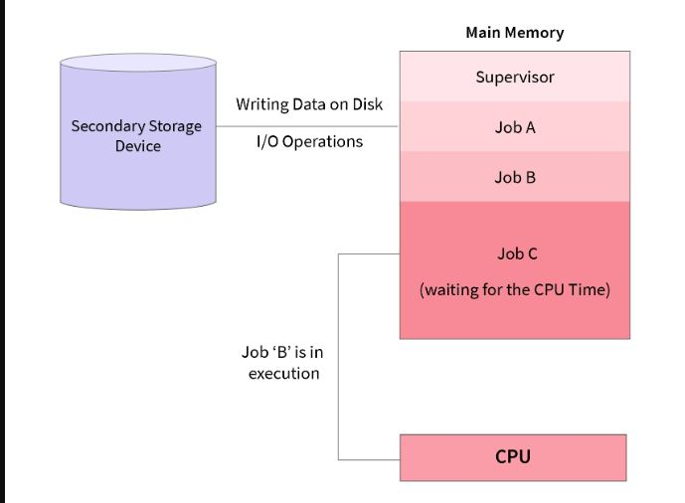
Multiprogramming
An operating system that is capable of running multiple programs on a single processor is known as a multiprogramming operating system.
If a program has to wait for an I/O transfer in a multiprogramming operating system, other programs utilize the CPU and other resources meanwhile.
One of the major aims of multiprogramming is to manage the various resources of the entire system
Main Memory (RAM)
Job 1
Job 2
Job 3
Job 4
0
512mb

Slide 14
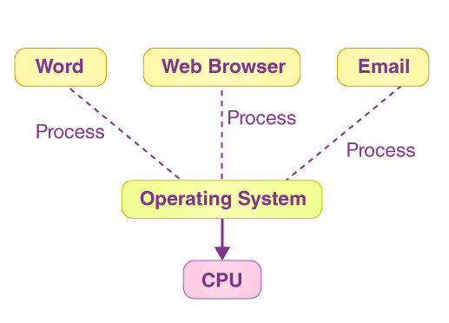
Multitasking (Time Sharing)
Each task is given some time to execute so that all the tasks work smoothly.
Each user gets the time of CPU as they use a single system.
These systems are also known as Multitasking Systems.
The task can be from a single user or different users also.
The time that each task gets to execute is called quantum.
After this time interval is over OS switches over to the next task.

Slide 15
Just to make it easy to remember, both multiprogramming and multitasking operating systems are (CPU) time sharing systems. However, while in multiprogramming (older OSs) one program as a whole keeps running until it blocks, in multitasking (modern OSs) time sharing is best manifested because each running process takes only a fair quantum of the CPU time.
Things to remember!

Slide 16
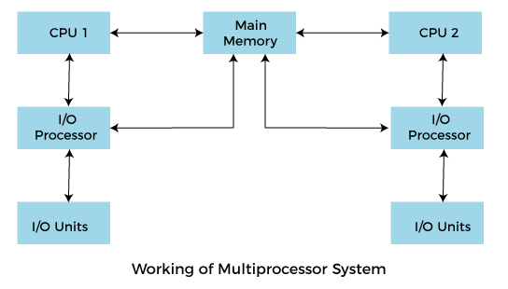
Multiprocessing
Multiprocessing means, there are more than one processor which work parallel to perform the required operations.
The main objective of using a multiprocessor operating system is to increase the execution speed of the system and consume high computing power.

Slide 17
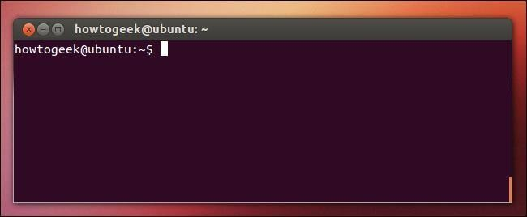
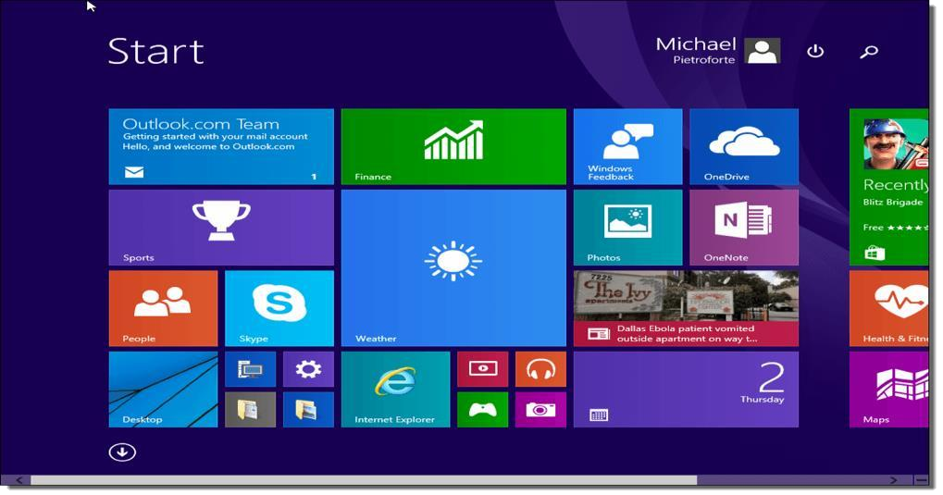
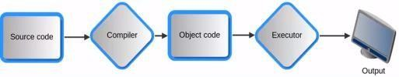
Operating System Services
User Interface
Allows the user to interact with the
computer.
Command line interface (Terminal)
Graphical user interface
Program Execution
Load the program into memory
Execute the program.

Slide 18
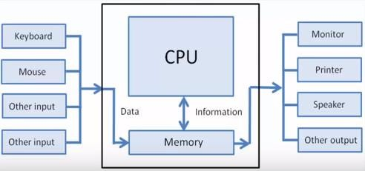
I/O Operations
File system manipulation (Creation, deletion, search)
Resource Allocation

Slide 19
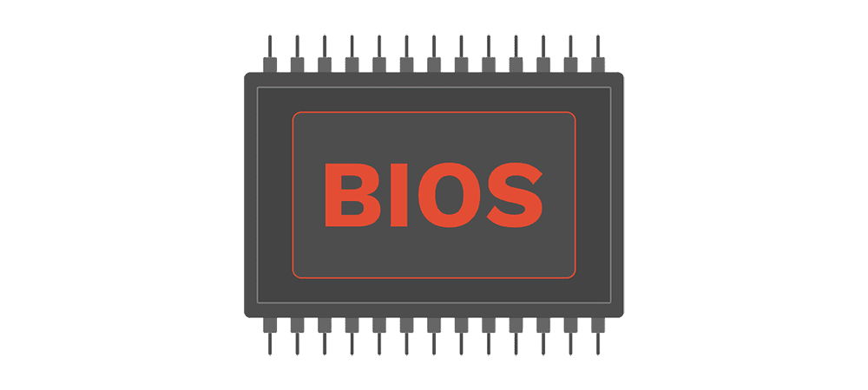
BIOS(Basic Input Output System)
BIOS is the program a computer's microprocessor uses to start the computer system after it is powered on.
It also manages data flow between the computer's operating system (OS) and attached devices, such as the hard disk, video adapter, keyboard, mouse and printer.
BIOS sets the machine in a state so that the operating system can be loaded, executed and given control of a PC.
Notes:
BIOS is software stored on a small memory chip (firmware) on the motherboard, and it is the very first software to run after a computer starts. The BIOS instructs the computer on how to perform basic functions such as booting and keyboard control

Slide 20
Important Terms and Definitions
Bootloader
Called by BIOS
A boot loader, also called a boot manager, is a small program that places the operating system of a computer into memory.
It is stored in the ROM.
It must know how to load the OS and start executing that system.
Process
In computing, a process is an instance of a computer program that is being executed. It contains the program code and its activity.
Kernel
A kernel is the central part of an operating system.
Notes:
The kernel is a computer program at the core of a computer's operating system and generally has complete control over everything in the system. It is the portion of the operating system code that is always resident in memory and facilitates interactions between hardware and software components.

